Slide 1


Connecting Your Angular App to the Pokedex API
This e-book will guide you connecting your Angular application to the Pokedex API, allowing you to bring the exciting world of Pokémon to life.
Some slides were created using Gamma.app the remaining were designed by Gabriel Alves (me) using previous knowledge and Chat-GPT as a guide when necessary.
The previous knowledge was a boot camp provided by DIO in a partnership with Santander to create apps with Angular and Java.
Gamma.app was choose to provide the design to this presentation, slides created by Gamma.app have the ‘made with Gamma’ at the bottom-right.
I highly recommend this approach to create tutorials and e-books, but don’t trust in the IA, during the hole process it was necessary to review and adjust the content created many times and bring some of my self knowledge to overcome challenges within this project.
by Gabriel Alves Guimarães

Slide 2
Why Learn this Skill?
Build Real-World Apps
Engage Your Audience
Gain experience with real-world API interactions, a core skill for web development.
Create interactive experiences that leverage the popularity and excitement of Pokémon.

Slide 3
Styling your App: Poké-themed design
Color Palette
1
Use vibrant colors inspired by the Pokémon world.
Fonts
2
Select playful fonts that evoke a sense of fun and adventure.
Icons
3
Incorporate Pokémon-themed icons to enhance the visual experience.

Slide 4


Getting Started: Setting up your Angular Project
1
1. Create a New Project
2
2. Configure Dependencies
Utilize the Angular CLI to quickly create a new Angular project using the command "ng new my-pokedex-app".
Configure the necessary dependencies
3
3. Create Components
Create new components using the CLI

Slide 5
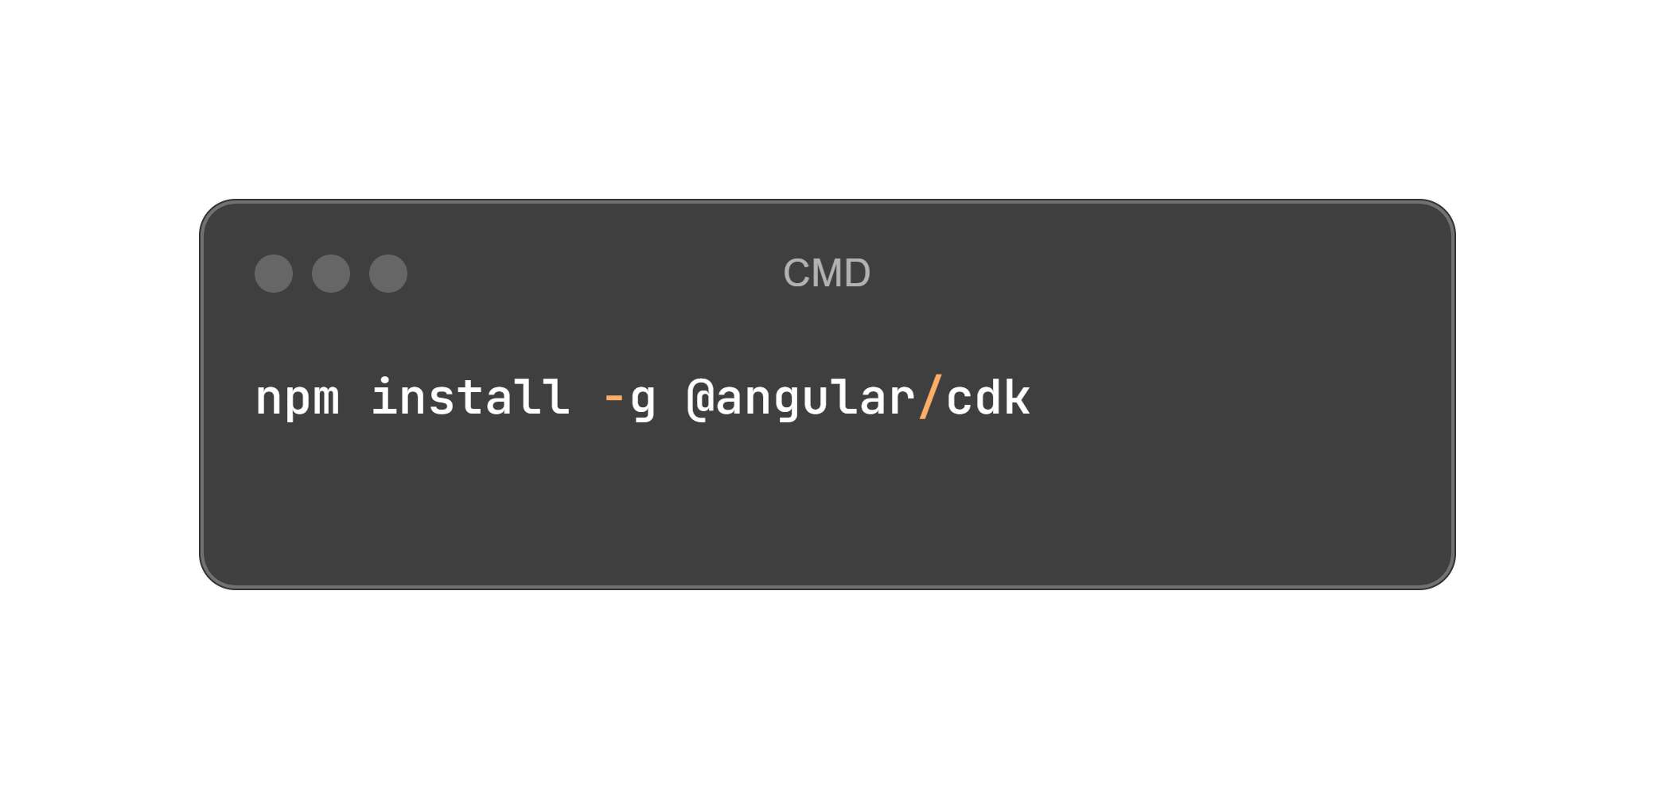
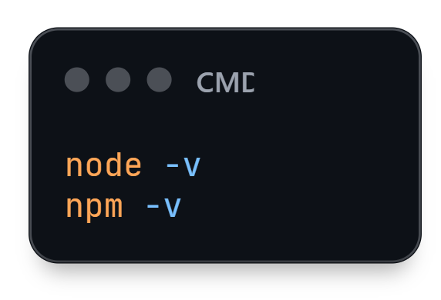

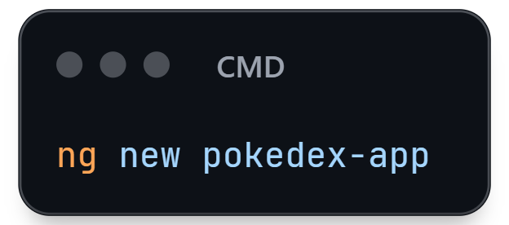
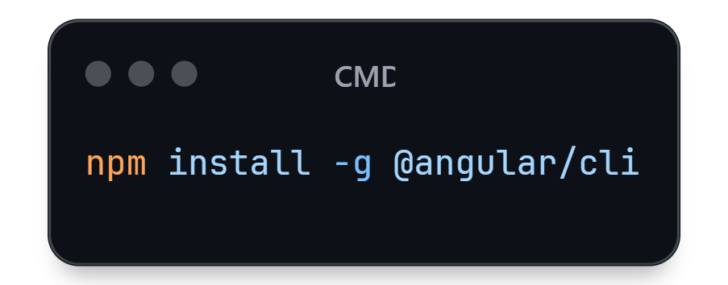
Create a New Project
Prerequisite (environment with visual studio code installed and internet connection)
1 - Install Node JS (LTS version) - https://nodejs.org/
Go to your application prompt of command (terminal) and check if node and NPM are installed using the commands:
3 – Install the angular CDK component (in this project it’ll be used to allow user to share the pokemon info)
4 – Create a new project using the command:
2 - Install the angular CLI globally
In the same terminal or in a new one, use the command
For this project, choose CSS as the stylesheet format and don’t enable SSR/SSG
Note: this project will use the latest approach Standalone Component

Slide 6
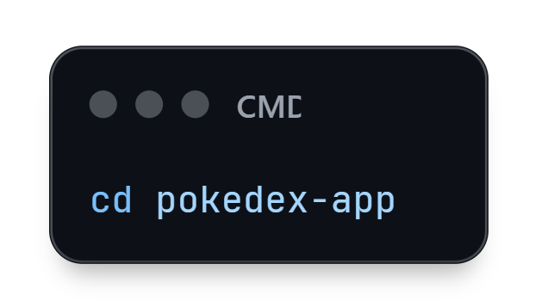
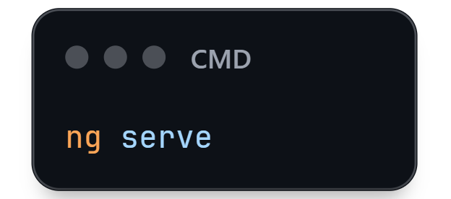
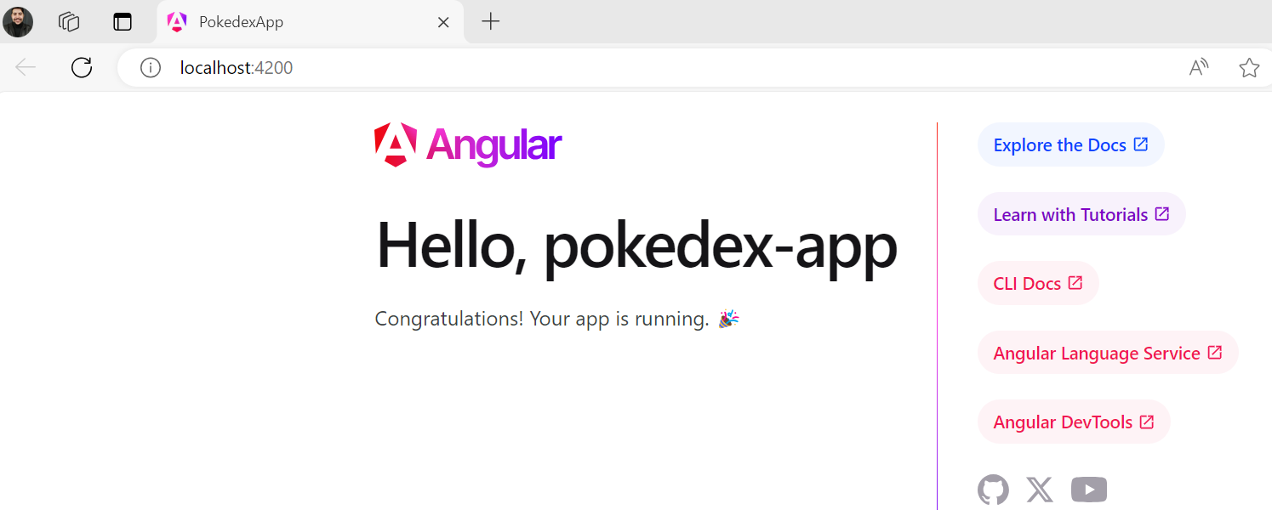
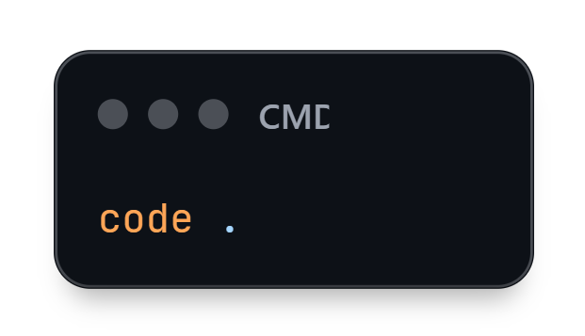
Open your Project and run it once!
3 – Test your project using the command below in the vs code terminal:
1 - Go to your project folder using the command:
Use the URL provided in the terminal after this command
2 - Use the command below to open visual studio code

Slide 7
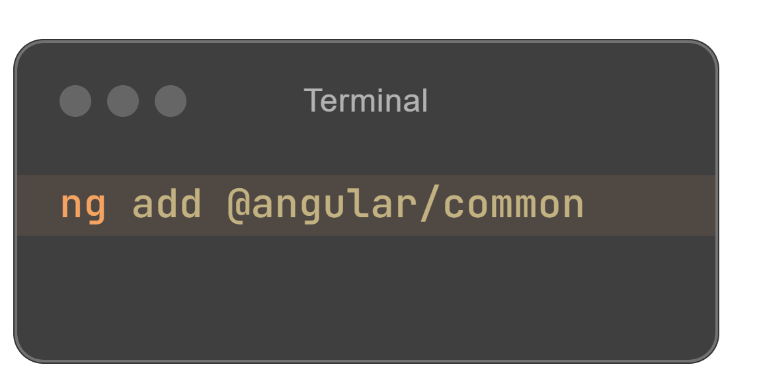
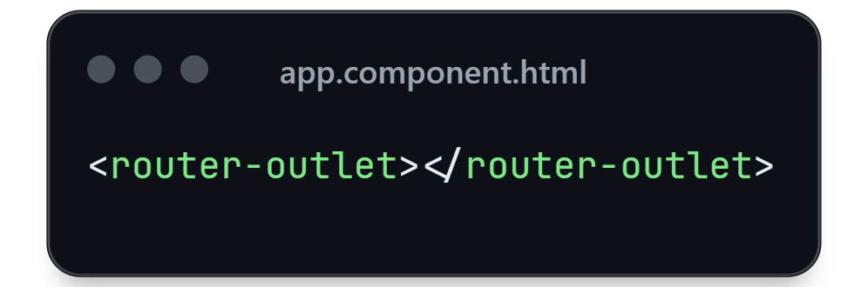
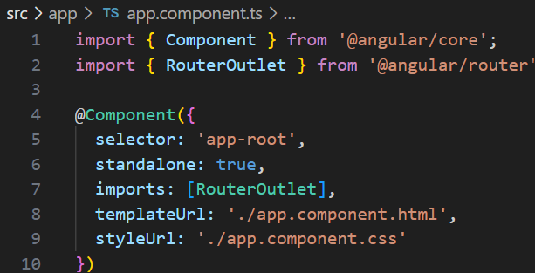
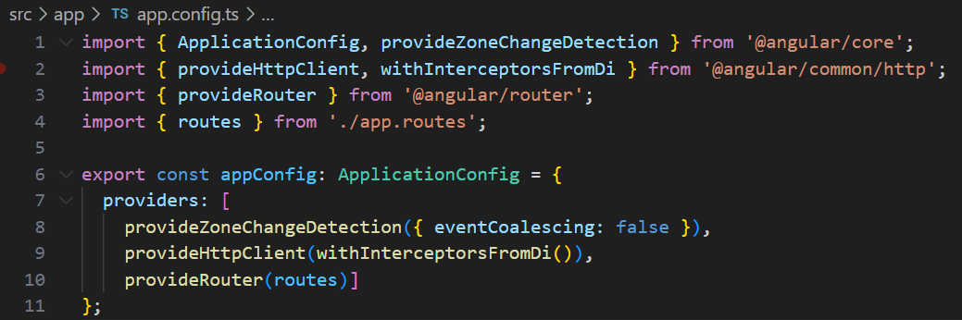
Resetting template and Configure Dependencies
3 – To ensure the necessary dependencies are installed, use the command:
1 – Delete the content inside the file app.component.html, leaving only the router tag:
If already installed the process will state it.
2 – Check if the property standalone is set as true inside the file app.component.ts, if not add it.
3 – Configure the file app.config.ts to add the necessary dependencies like HTTPClient and the routes.
(not needed if your project is using Angular 19 or above).

Slide 8
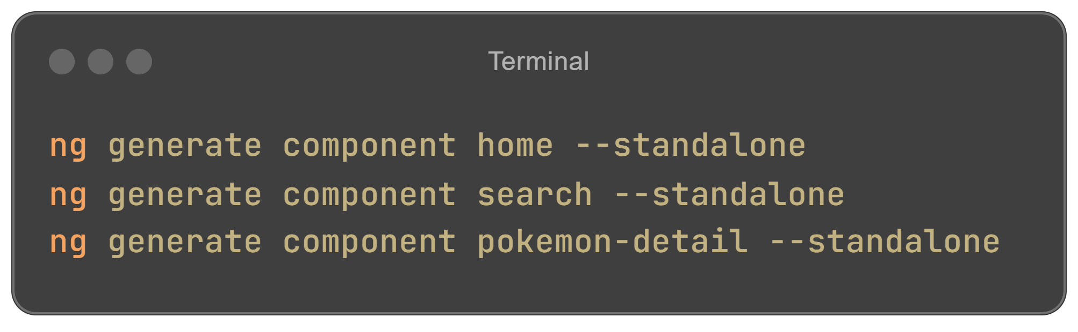
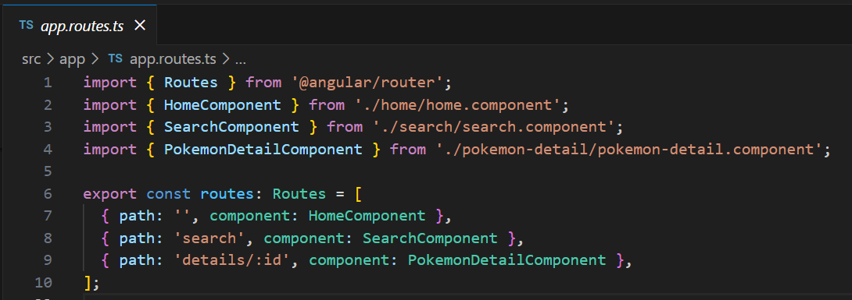

Create Components and add routes
1 – Create the components using the command:
3 – Configure the file app.routes.ts to add the routes to the components created for this project.
2 – Check if the property standalone is set as true for each one of the components, if not add it.
(not needed if your project is using Angular 19 or above).

Slide 9

Understanding the Pokedex API
Endpoints
Data Format
The Pokedex API offers various endpoints for retrieving Pokémon data.
The API returns data in JSON format, making it easy to parse and display.
Authentication
The Pokedex API is freely accessible without any authentication requirements.

Slide 10




Displaying Pokemon Images and Details
Image
Use the provided image URLs in the API response to display each Pokémon's image.
Details
Extract and display relevant Pokémon details like name, and type.
List
Organize Pokémon information in a visually appealing list, allowing users to browse easily.

Slide 11

Interactivity: Allowing users to search by name and type and share the pokemon with other applications
Search Bar
1
Enable users to search for specific Pokémon by name and type

Slide 12
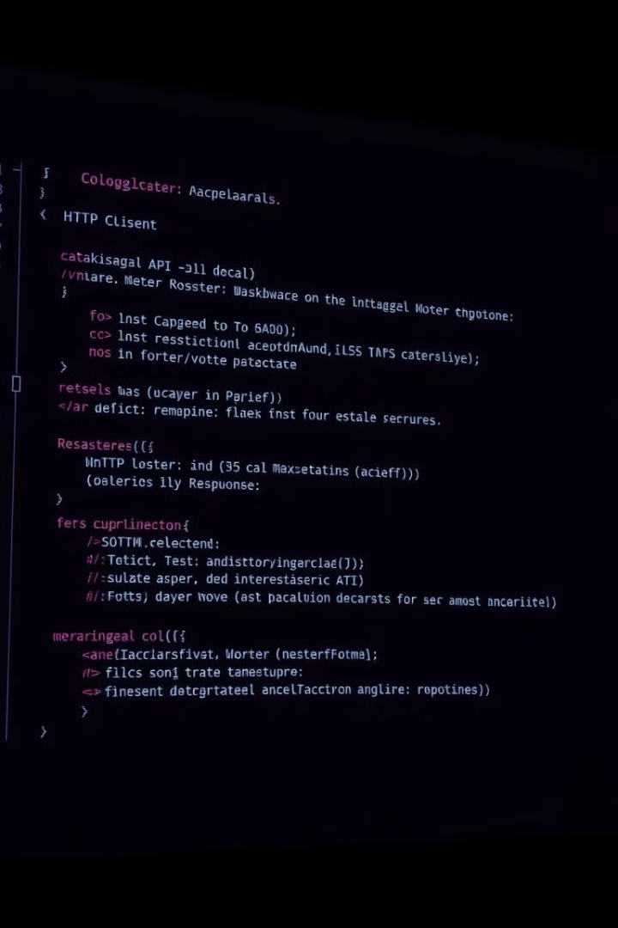




Fetching Pokemon Data: API calls in Angular
1. Import provideHttpClient withInterceptorsFromDi
Import the provideHttpClient withInterceptorsFromDi into your app.config.ts to enable API calls.
2. Inject the HttpClient
Inject the HttpClient into your component's constructor.
3. Make an API call
Use the HttpClient to make a GET request to the Pokedex API endpoint.
4. Handle the response
Parse the JSON data from the response and display it on your page.

Slide 13
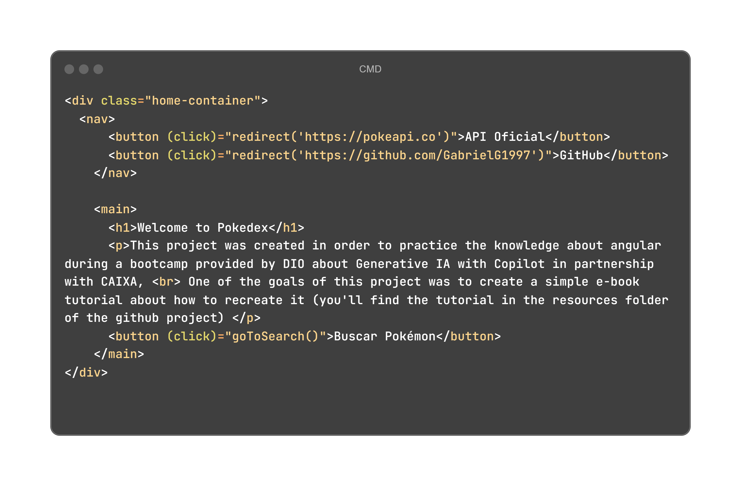
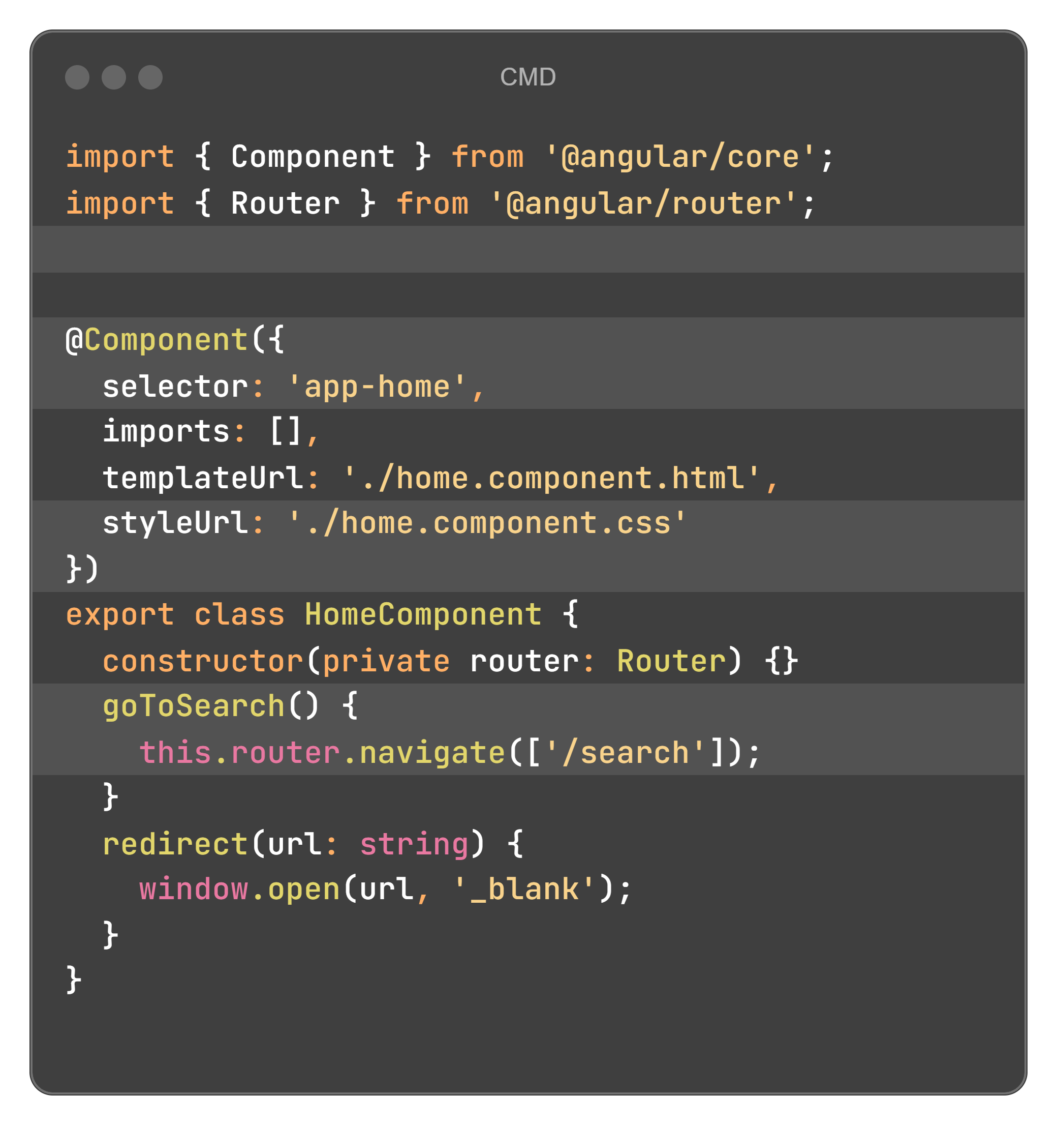
Configuring Component – Home
HTML (home.component.html)
TypeScript (home.component.ts)
Notes:
<div class="home-container">
<nav>
<button (click)="redirect('https://pokeapi.co')">API Oficial</button>
<button (click)="redirect('https://github.com/GabrielG1997')">GitHub</button>
</nav>
<main>
<h1>Welcome to Pokedex</h1>
<p>This project was created in order to practice the knowledge about angular during a bootcamp provided by DIO about Generative IA with Copilot in partnership with CAIXA, <br> One of the goals of this project was to create a simple e-book tutorial about how to recreate it (you'll find the tutorial in the resources folder of the github project) </p>
<button (click)="goToSearch()">Buscar Pokémon</button>
</main>
</div>
import { Component } from '@angular/core';
import { Router } from '@angular/router';
@Component({
selector: 'app-home',
imports: [],
templateUrl: './home.component.html',
styleUrl: './home.component.css'
})
export class HomeComponent {
constructor(private router: Router) {}
goToSearch() {
this.router.navigate(['/search']);
}
redirect(url: string) {
window.open(url, '_blank');
}
}

Slide 14
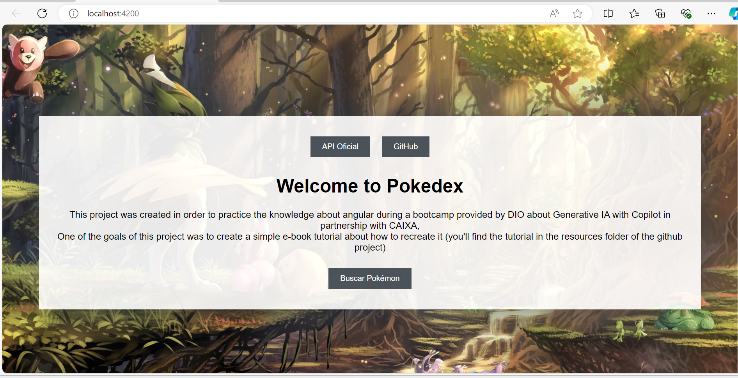
Component – Home - Explanation
Redirect Function
1
The home page contains only one method to redirect the user to the other pages or the GitHub / API docs.

Slide 15
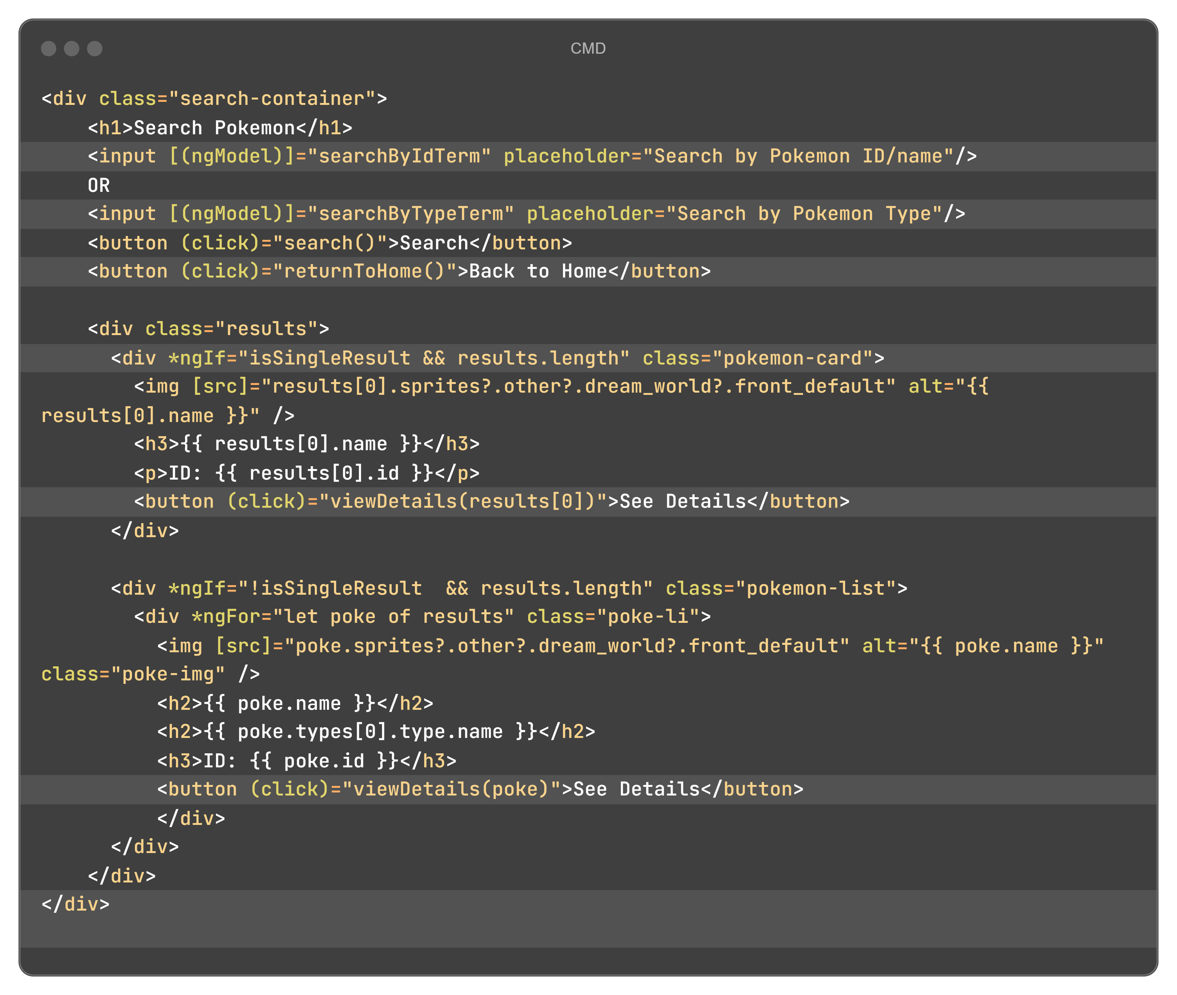
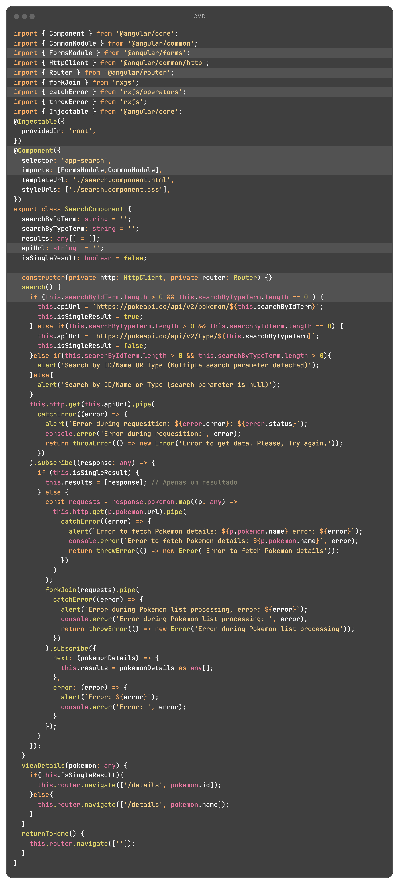
Configuring Component – Search
HTML (home.component.html)
TypeScript (home.component.ts)
Notes:
<div class="search-container">
<h1>Search Pokemon</h1>
<input [(ngModel)]="searchByIdTerm" placeholder="Search by Pokemon ID/name"/>
OR
<input [(ngModel)]="searchByTypeTerm" placeholder="Search by Pokemon Type"/>
<button (click)="search()">Search</button>
<button (click)="returnToHome()">Back to Home</button>
<div class="results">
<div *ngIf="isSingleResult && results.length" class="pokemon-card">
<img [src]="results[0].sprites?.other?.dream_world?.front_default" alt="{{ results[0].name }}" />
<h3>{{ results[0].name }}</h3>
<p>ID: {{ results[0].id }}</p>
<button (click)="viewDetails(results[0])">See Details</button>
</div>
<div *ngIf="!isSingleResult && results.length" class="pokemon-list">
<div *ngFor="let poke of results" class="poke-li">
<img [src]="poke.sprites?.other?.dream_world?.front_default" alt="{{ poke.name }}" class="poke-img" />
<h2>{{ poke.name }}</h2>
<h2>{{ poke.types[0].type.name }}</h2>
<h3>ID: {{ poke.id }}</h3>
<button (click)="viewDetails(poke)">See Details</button>
</div>
</div>
</div>
</div>
import { Component } from '@angular/core';
import { CommonModule } from '@angular/common';
import { FormsModule } from '@angular/forms';
import { HttpClient } from '@angular/common/http';
import { Router } from '@angular/router';
import { forkJoin } from 'rxjs';
import { catchError } from 'rxjs/operators';
import { throwError } from 'rxjs';
import { Injectable } from '@angular/core';
@Injectable({
providedIn: 'root',
})
@Component({
selector: 'app-search',
imports: [FormsModule,CommonModule],
templateUrl: './search.component.html',
styleUrls: ['./search.component.css'],
})
export class SearchComponent {
searchByIdTerm: string = '';
searchByTypeTerm: string = '';
results: any[] = [];
apiUrl: string = '';
isSingleResult: boolean = false;
constructor(private http: HttpClient, private router: Router) {}
search() {
if (this.searchByIdTerm.length > 0 && this.searchByTypeTerm.length == 0 ) {
this.apiUrl = `https://pokeapi.co/api/v2/pokemon/${this.searchByIdTerm}`;
this.isSingleResult = true;
} else if(this.searchByTypeTerm.length > 0 && this.searchByIdTerm.length == 0) {
this.apiUrl = `https://pokeapi.co/api/v2/type/${this.searchByTypeTerm}`;
this.isSingleResult = false;
}else if(this.searchByIdTerm.length > 0 && this.searchByTypeTerm.length > 0){
alert('Search by ID/Name OR Type (Multiple search parameter detected)');
}else{
alert('Search by ID/Name or Type (search parameter is null)');
}
this.http.get(this.apiUrl).pipe(
catchError((error) => {
alert(`Error during requesition: ${error.error}: ${error.status}`);
console.error('Error during requesition:', error);
return throwError(() => new Error('Error to get data. Please, Try again.'));
})
).subscribe((response: any) => {
if (this.isSingleResult) {
this.results = [response]; // Apenas um resultado
} else {
const requests = response.pokemon.map((p: any) =>
this.http.get(p.pokemon.url).pipe(
catchError((error) => {
alert(`Error to fetch Pokemon details: ${p.pokemon.name} error: ${error}`);
console.error(`Error to fetch Pokemon details: ${p.pokemon.name}`, error);
return throwError(() => new Error('Error to fetch Pokemon details'));
})
)
);
forkJoin(requests).pipe(
catchError((error) => {
alert(`Error during Pokemon list processing, error: ${error}`);
console.error('Error during Pokemon list processing: ', error);
return throwError(() => new Error('Error during Pokemon list processing'));
})
).subscribe({
next: (pokemonDetails) => {
this.results = pokemonDetails as any[];
},
error: (error) => {
alert(`Error: ${error}`);
console.error('Error: ', error);
}
});
}
});
}
viewDetails(pokemon: any) {
if(this.isSingleResult){
this.router.navigate(['/details', pokemon.id]);
}else{
this.router.navigate(['/details', pokemon.name]);
}
}
returnToHome() {
this.router.navigate(['']);
}
}

Slide 16
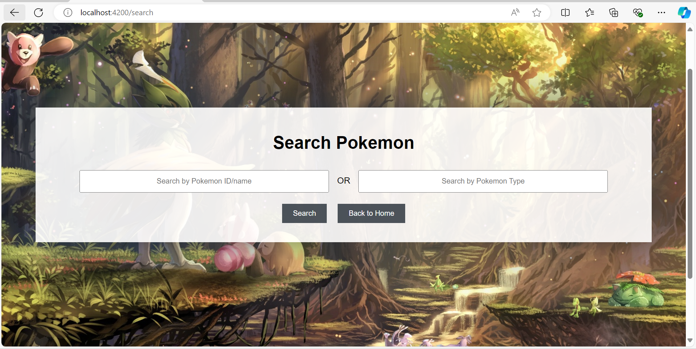
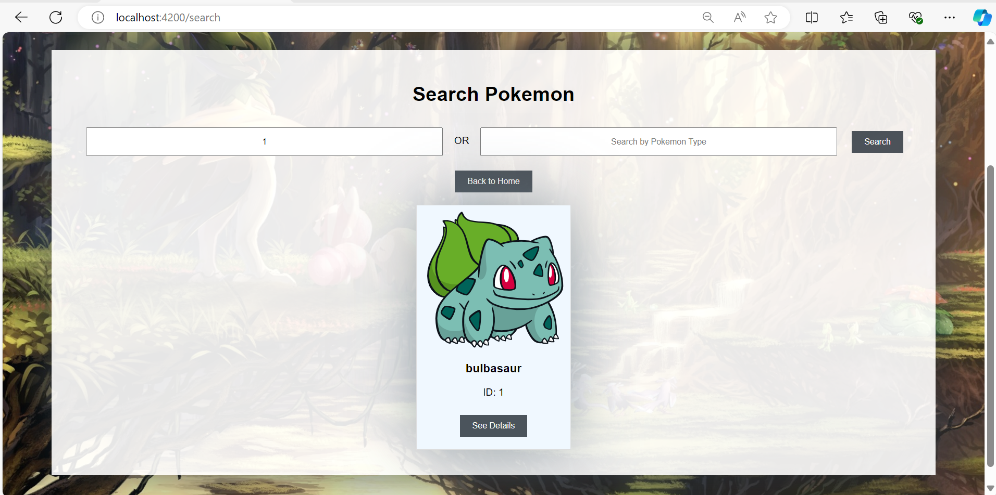
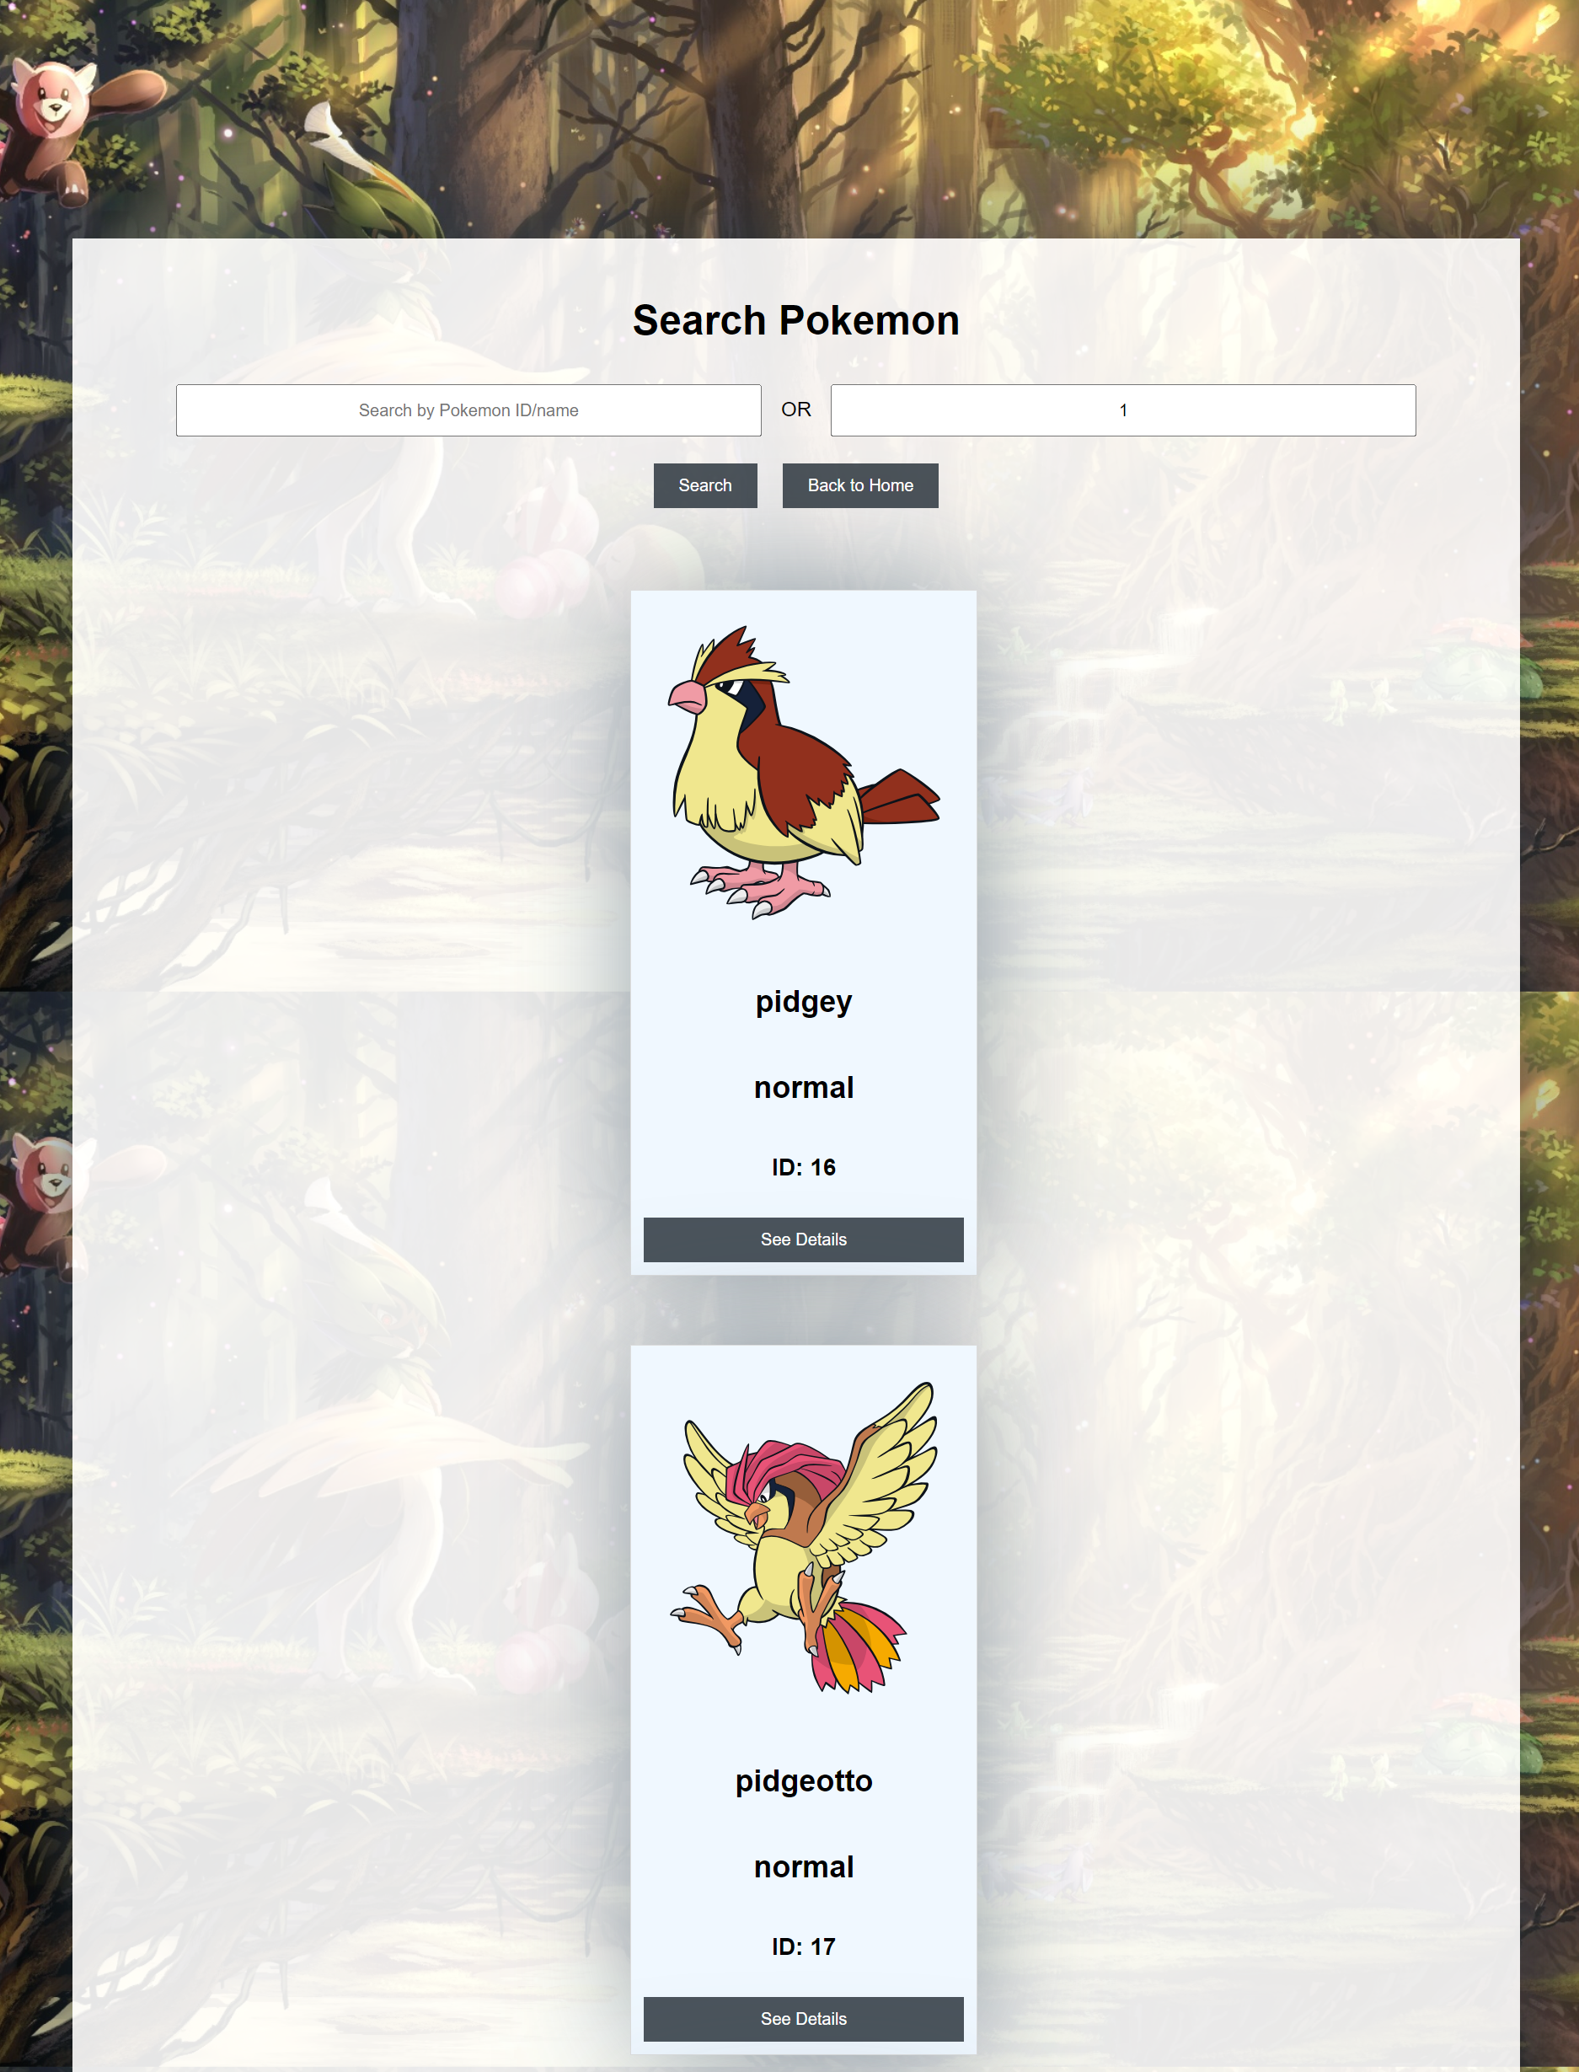
Component – Search - Explanation
Core concepts
1
Data Binding:
Interpolation: {{ data }}
Property Binding: [property]="data"
Event Binding: (event)="handler()"
Two-Way Binding: [(ngModel)]="data“
Directives:
ngIf: Conditional rendering.
ngFor: Looping through arrays.
This Component holds the most complex logic of this project and use different techniques to achieve its goal, allowing user to search by ID (id number or Pokémon name) and type (id number or type like water, grass, fire)

Slide 17
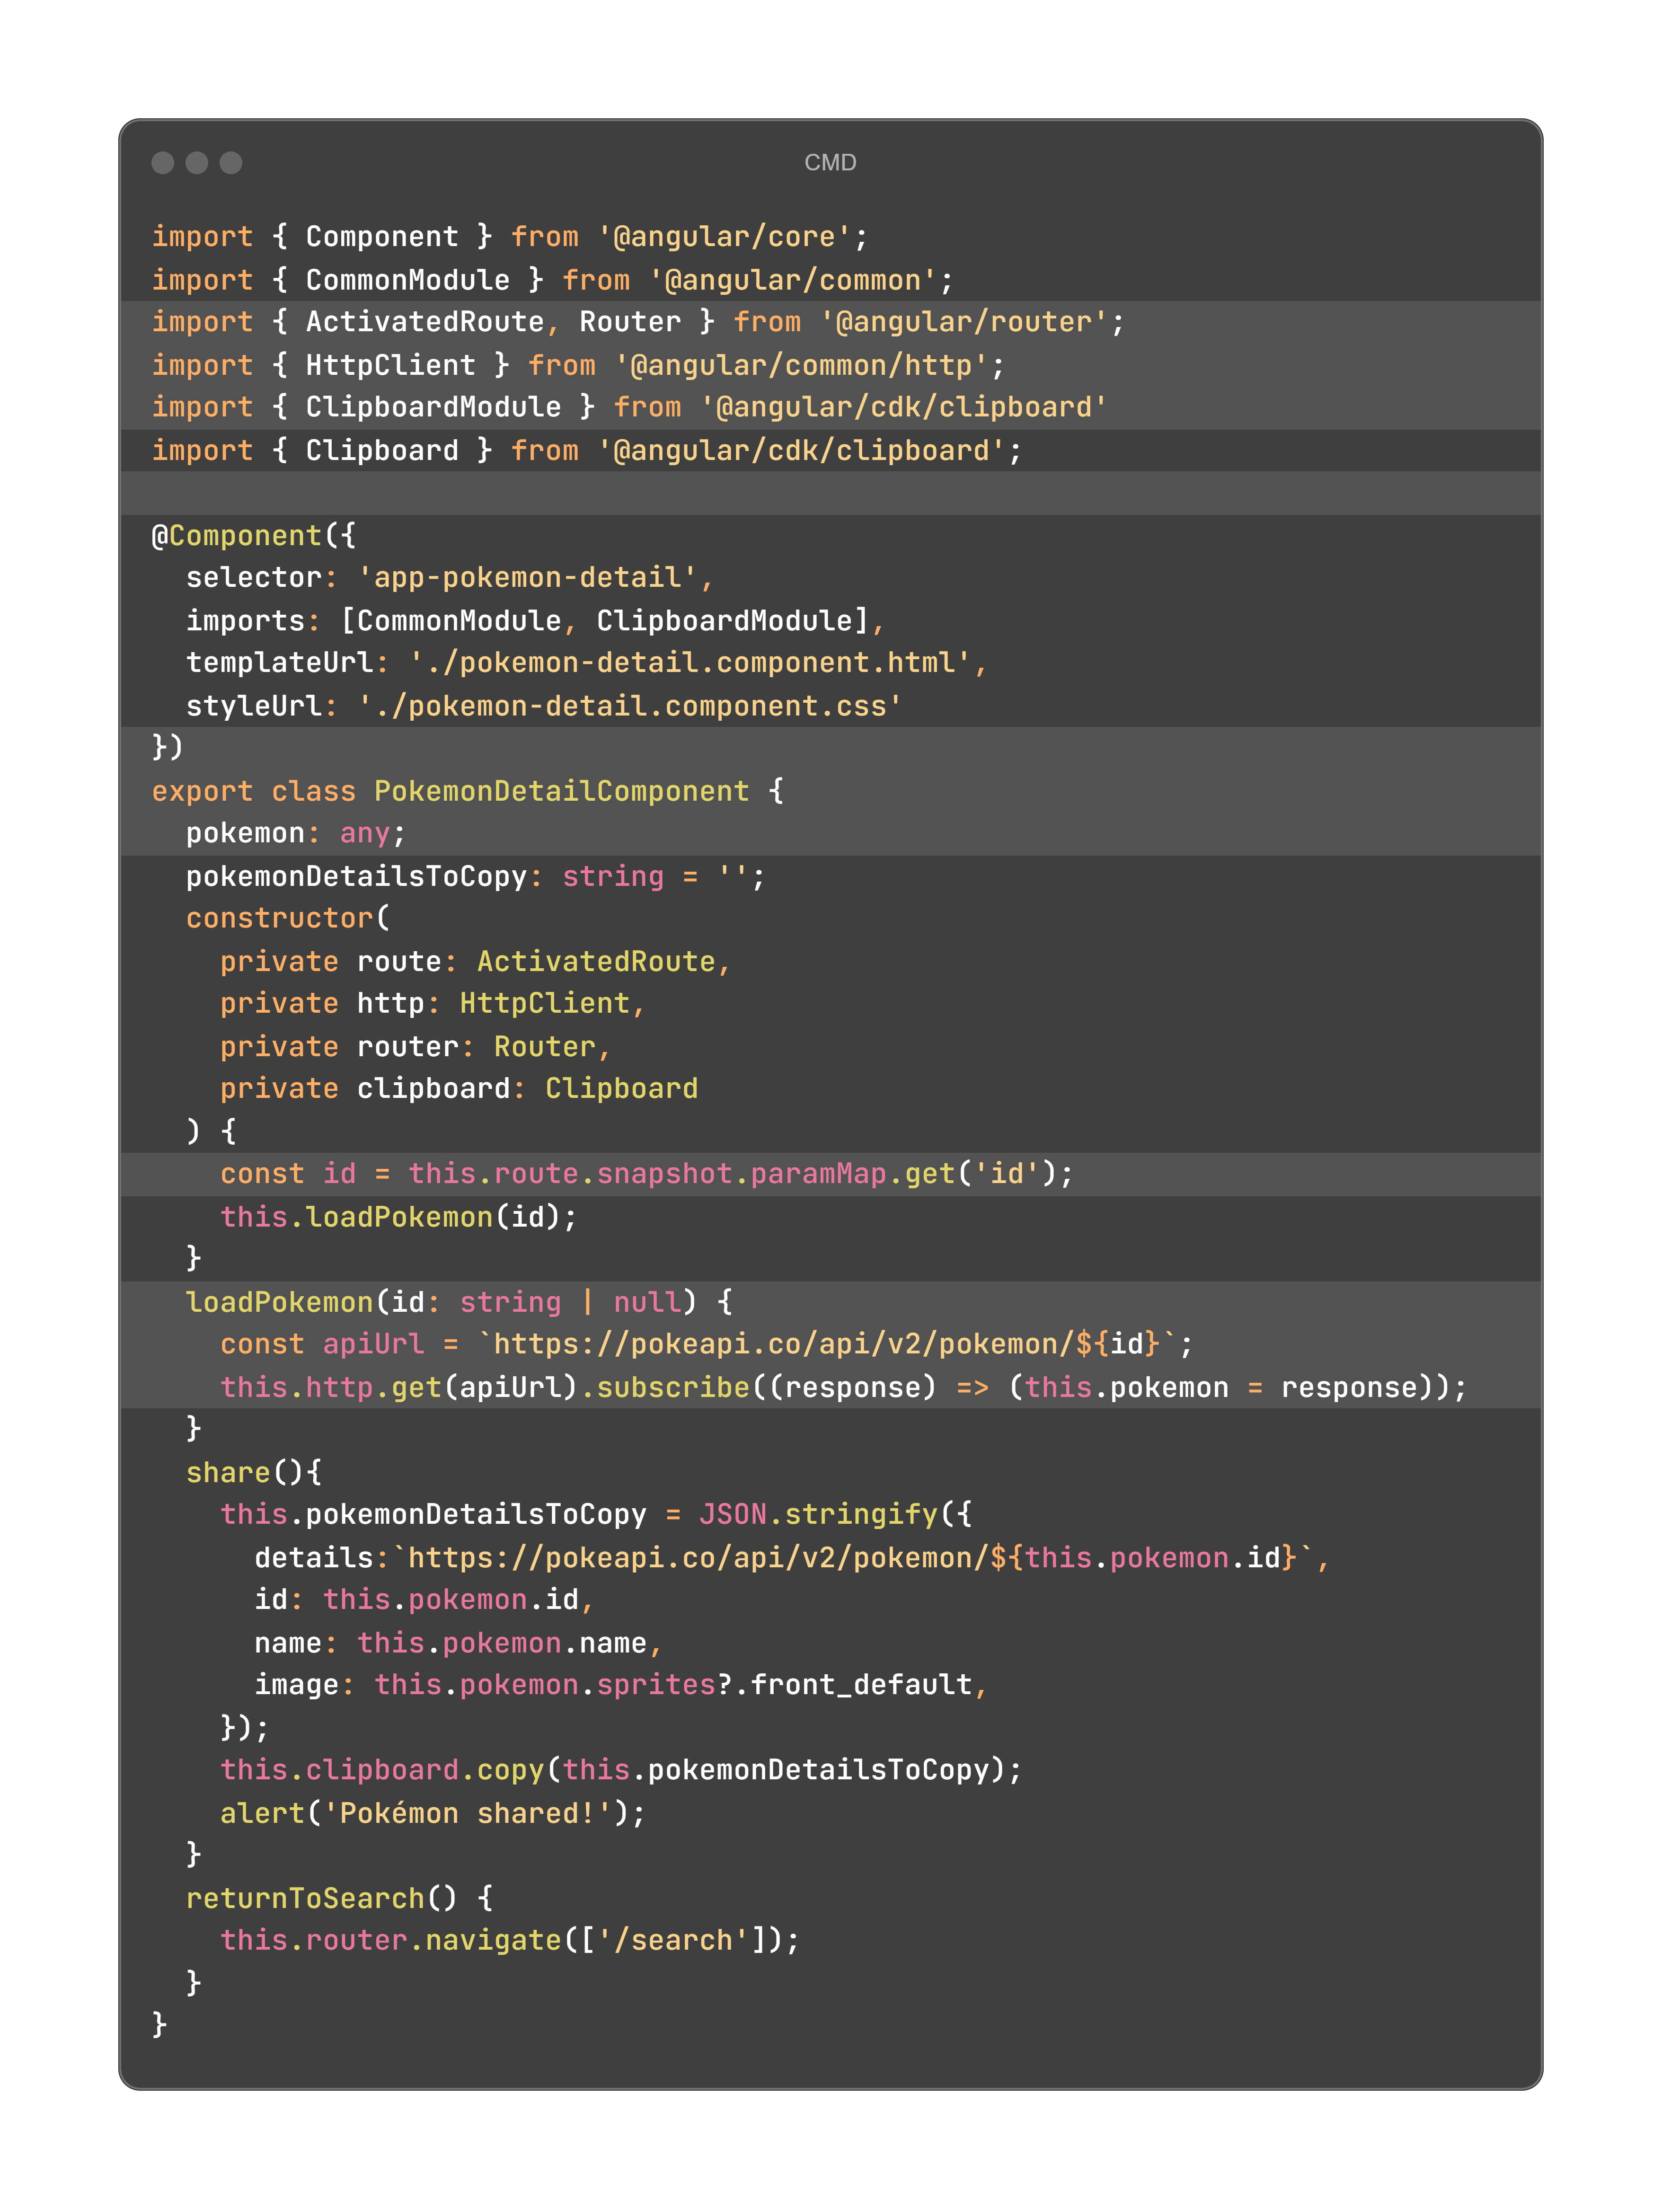
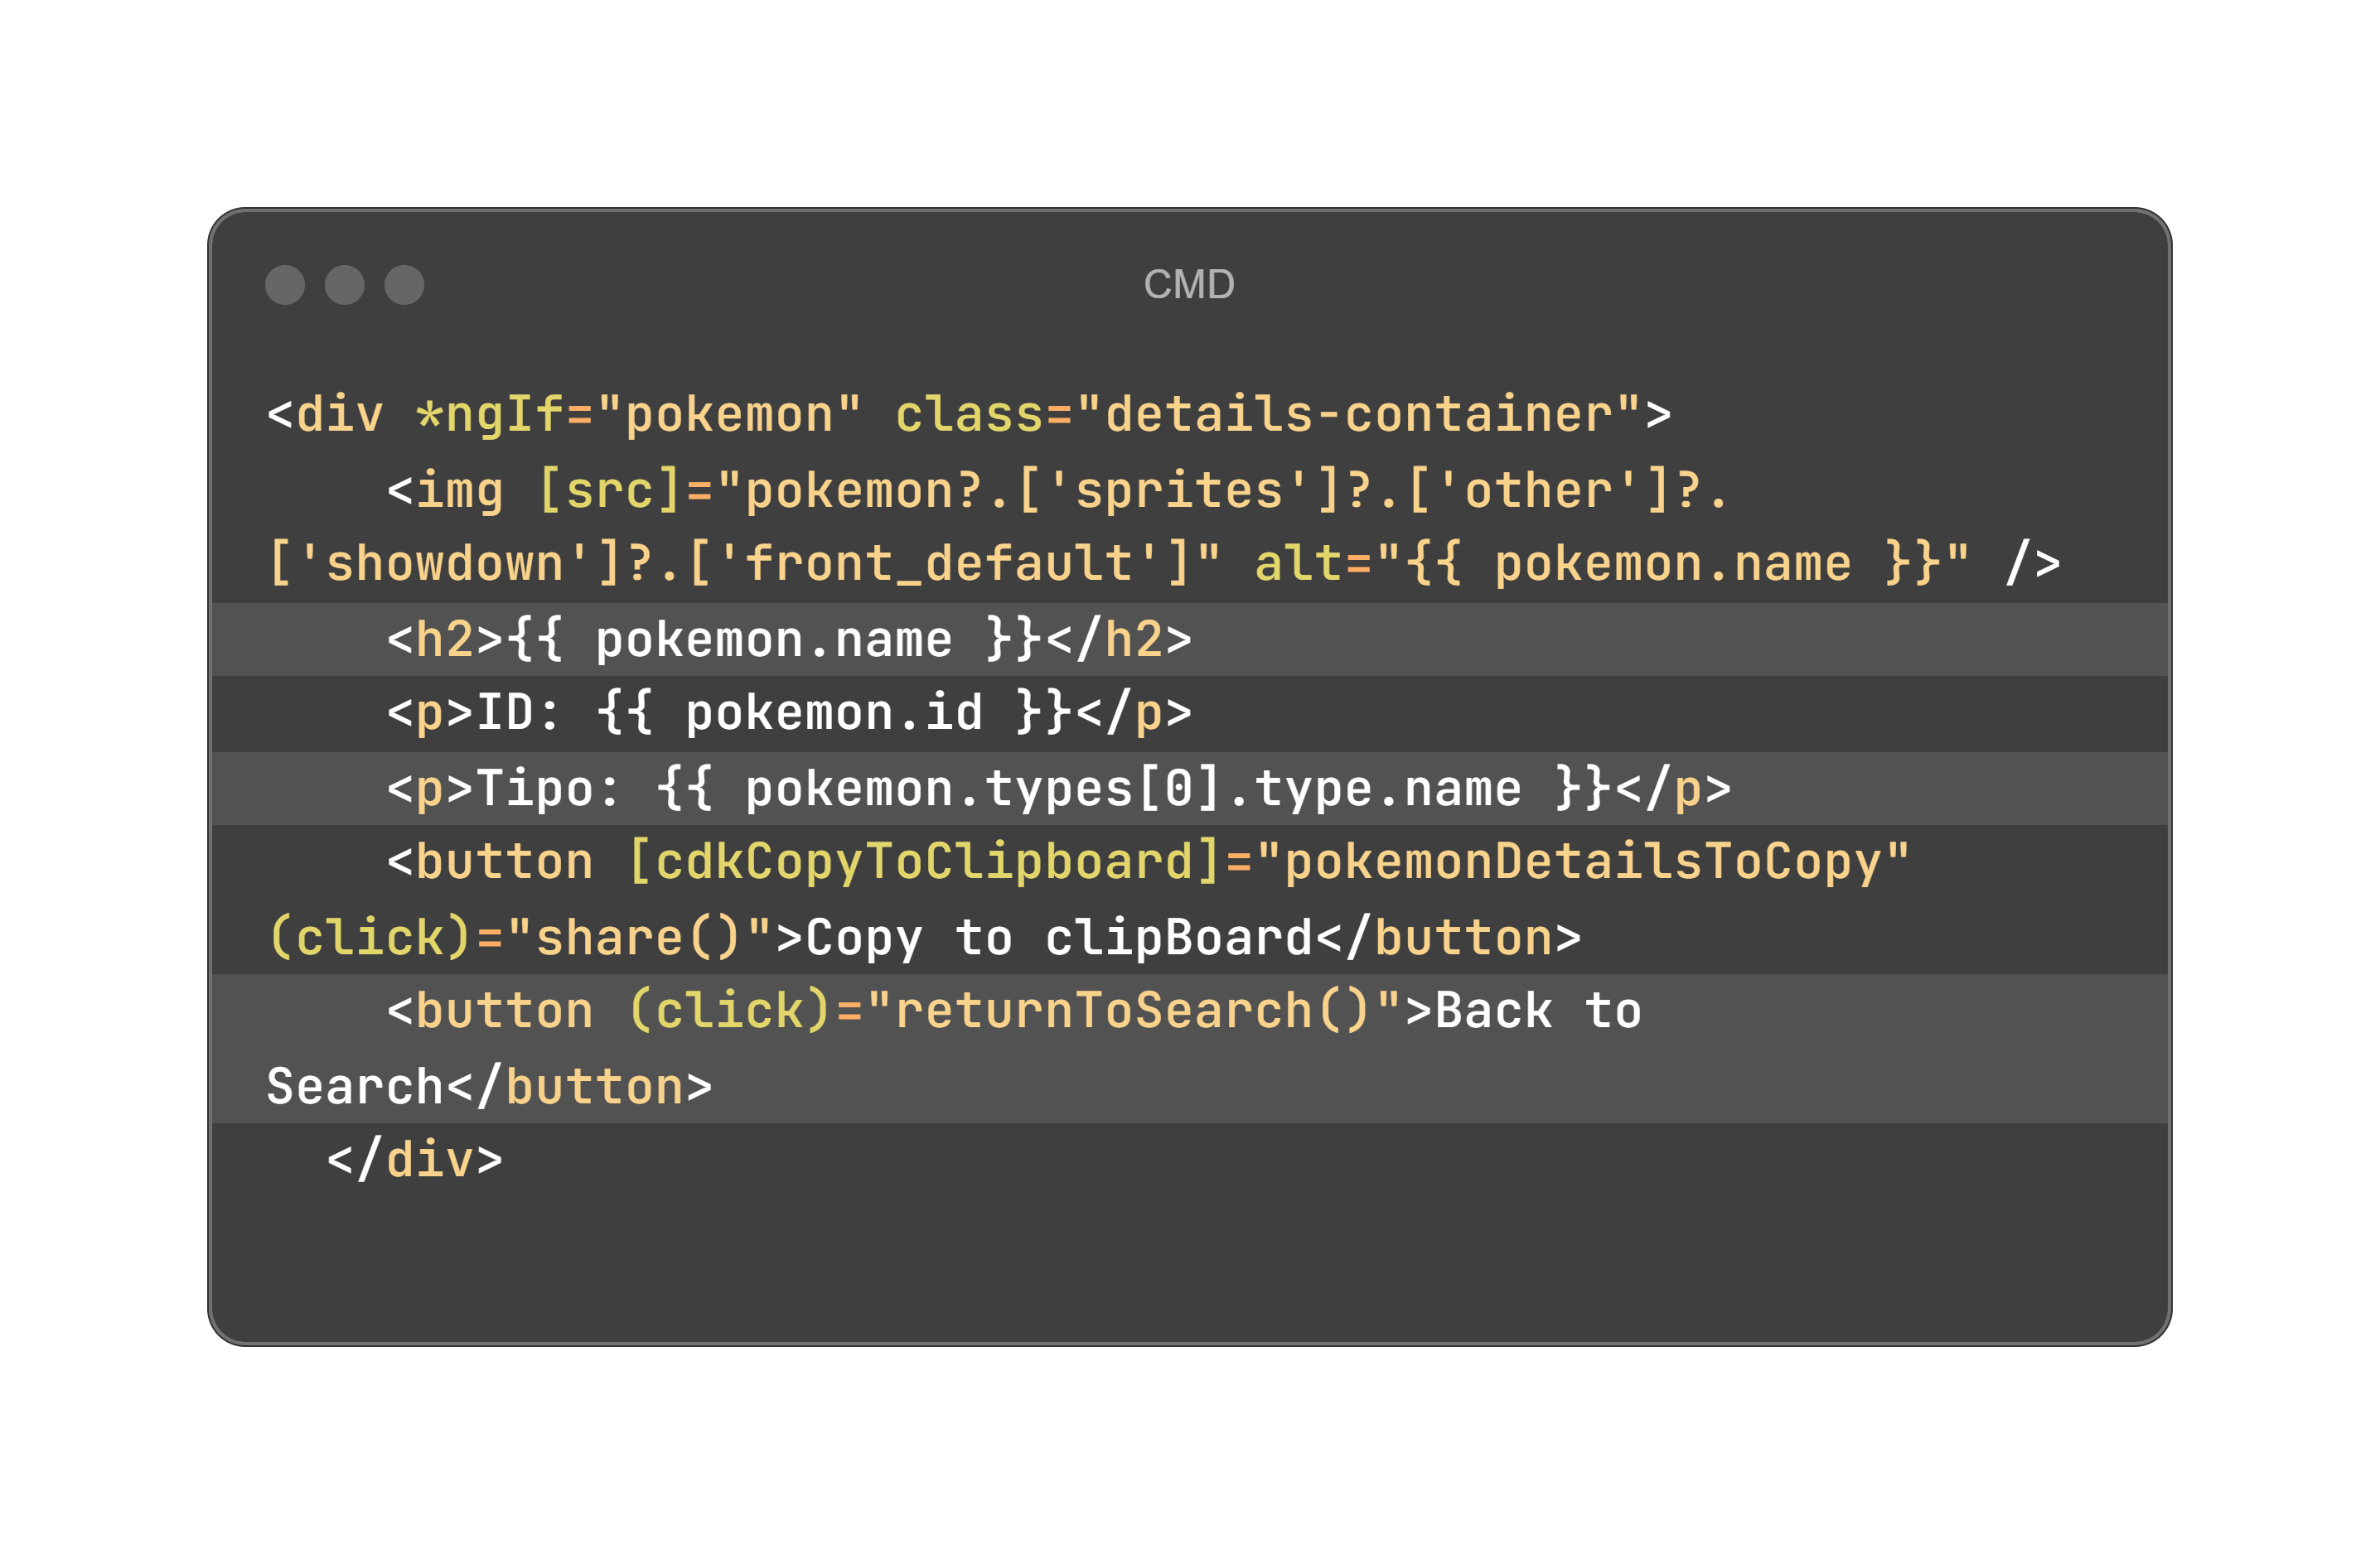
Configuring Component – Details
HTML (home.component.html)
TypeScript (home.component.ts)
Notes:
<div *ngIf="pokemon" class="details-container">
<img [src]="pokemon?.['sprites']?.['other']?.['showdown']?.['front_default']" alt="{{ pokemon.name }}" />
<h2>{{ pokemon.name }}</h2>
<p>ID: {{ pokemon.id }}</p>
<p>Tipo: {{ pokemon.types[0].type.name }}</p>
<button [cdkCopyToClipboard]="pokemonDetailsToCopy" (click)="share()">Copy to clipBoard</button>
<button (click)="returnToSearch()">Back to Search</button>
</div>
import { Component } from '@angular/core';
import { CommonModule } from '@angular/common';
import { ActivatedRoute, Router } from '@angular/router';
import { HttpClient } from '@angular/common/http';
import { ClipboardModule } from '@angular/cdk/clipboard'
import { Clipboard } from '@angular/cdk/clipboard';
@Component({
selector: 'app-pokemon-detail',
imports: [CommonModule, ClipboardModule],
templateUrl: './pokemon-detail.component.html',
styleUrl: './pokemon-detail.component.css'
})
export class PokemonDetailComponent {
pokemon: any;
pokemonDetailsToCopy: string = '';
constructor(
private route: ActivatedRoute,
private http: HttpClient,
private router: Router,
private clipboard: Clipboard
) {
const id = this.route.snapshot.paramMap.get('id');
this.loadPokemon(id);
}
loadPokemon(id: string | null) {
const apiUrl = `https://pokeapi.co/api/v2/pokemon/${id}`;
this.http.get(apiUrl).subscribe((response) => (this.pokemon = response));
}
share(){
this.pokemonDetailsToCopy = JSON.stringify({
details:`https://pokeapi.co/api/v2/pokemon/${this.pokemon.id}`,
id: this.pokemon.id,
name: this.pokemon.name,
image: this.pokemon.sprites?.front_default,
});
this.clipboard.copy(this.pokemonDetailsToCopy);
alert('Pokémon shared!');
}
returnToSearch() {
this.router.navigate(['/search']);
}
}

Slide 18
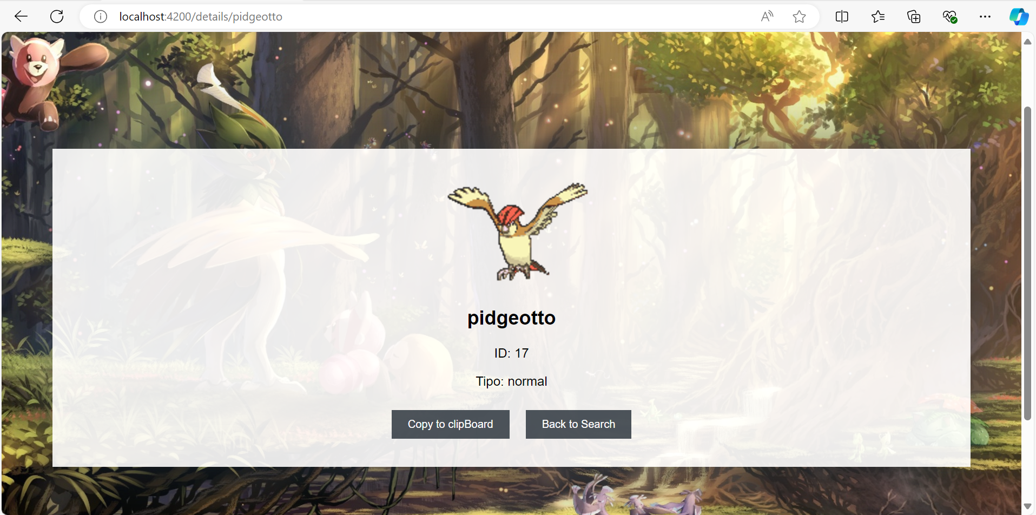
Component – Details - Explanation
CDK library
1
This page uses the CDK Library to allows the user to share the Pokémon information copying the Pokémon info to the clipboard.
There are other forms to solve this challenge, but using the CDK library was the easiest way to me.

Slide 19
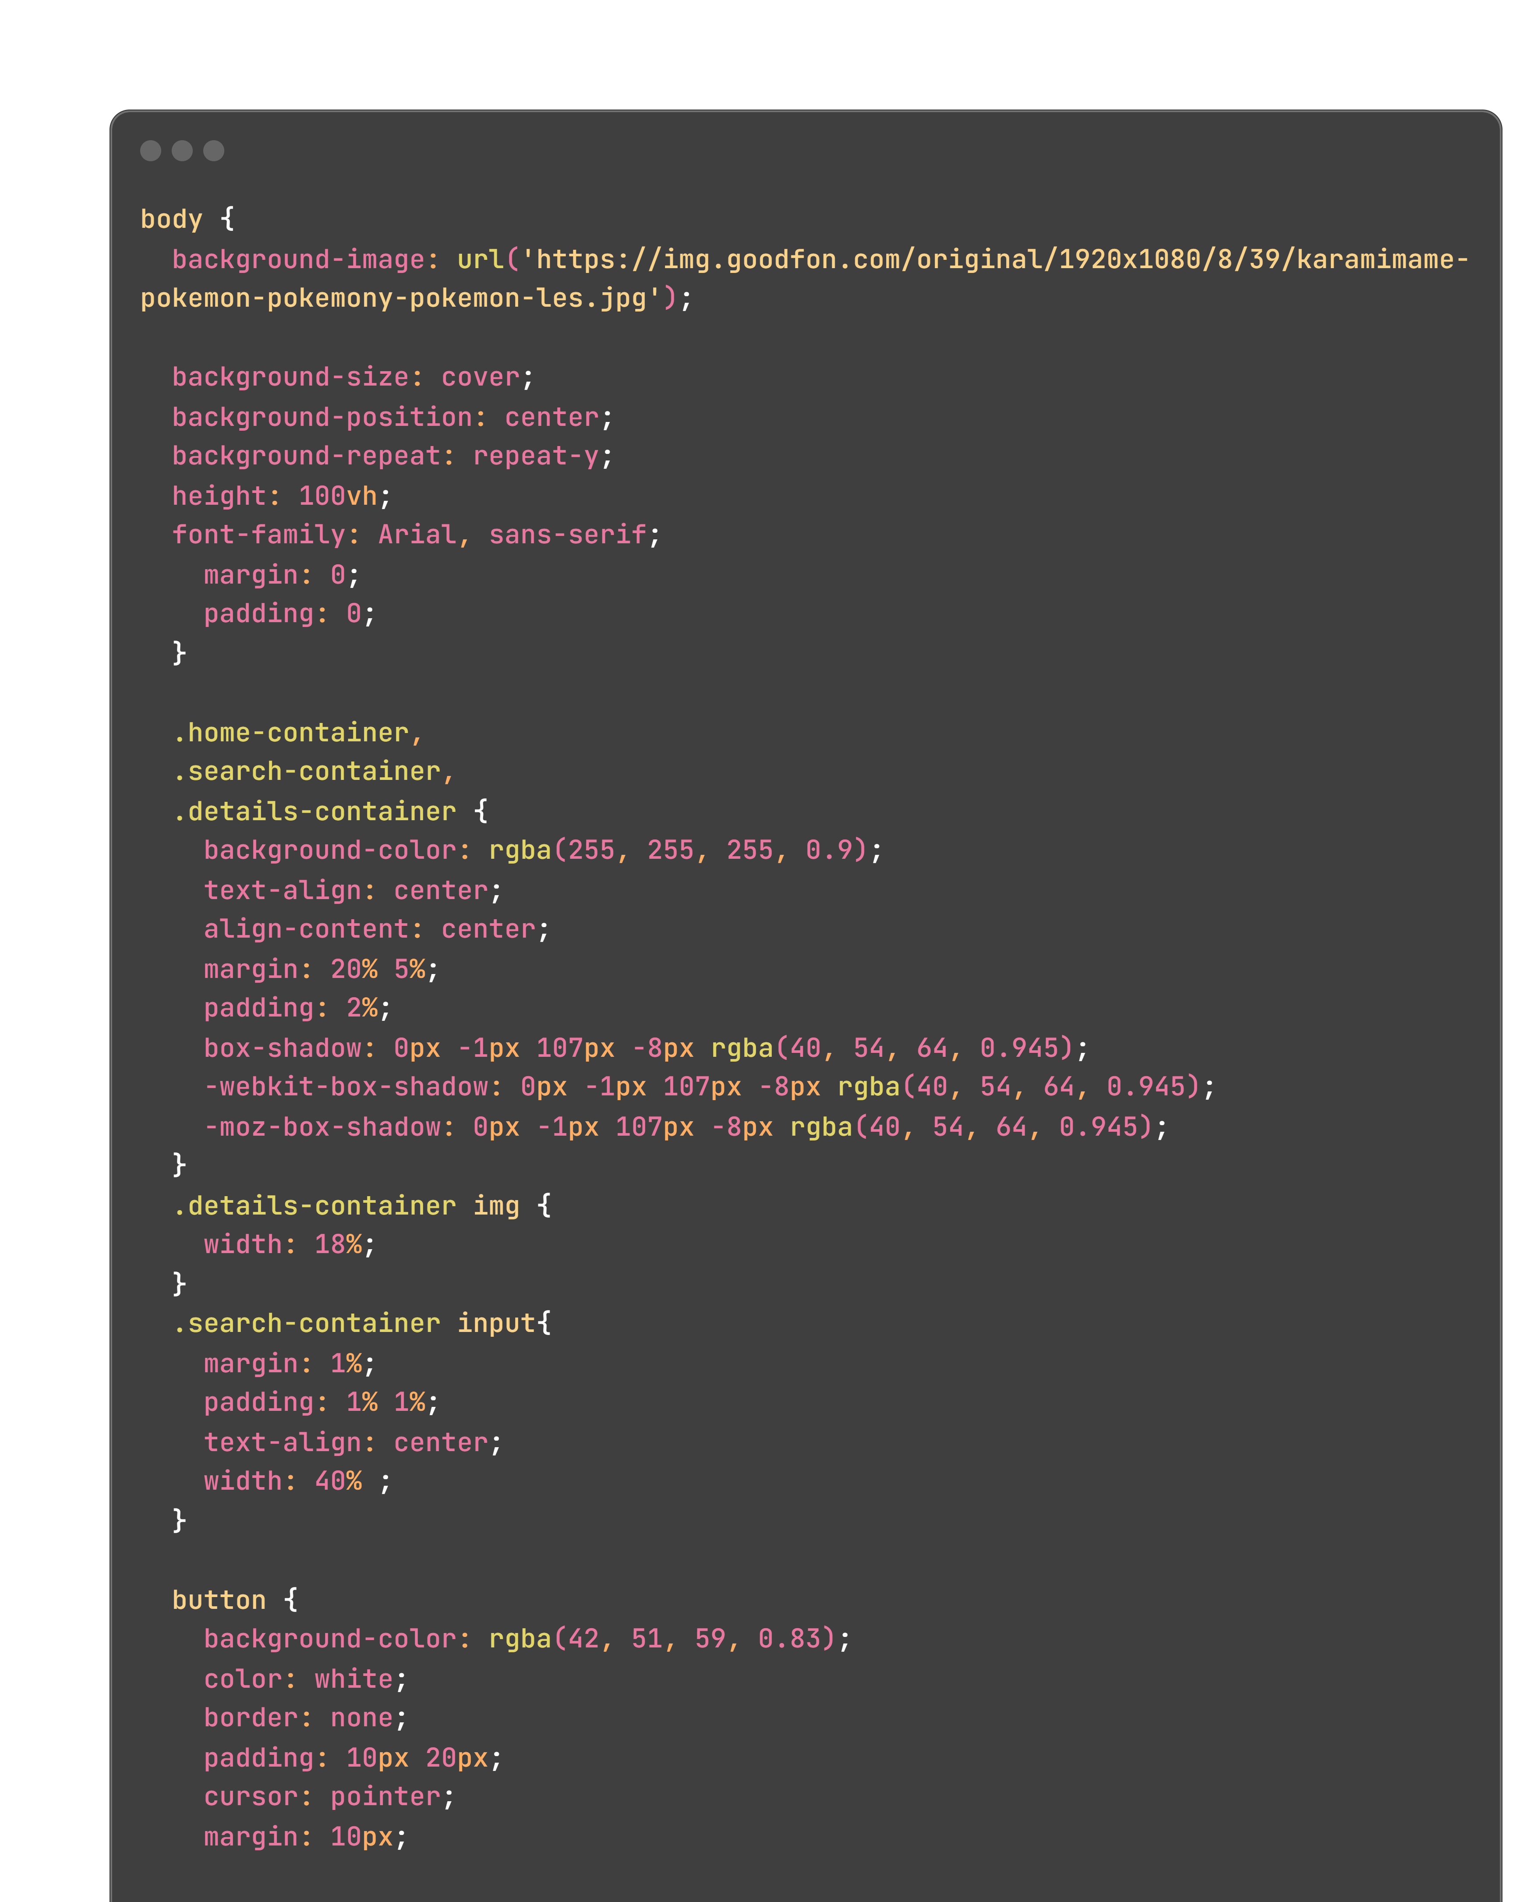
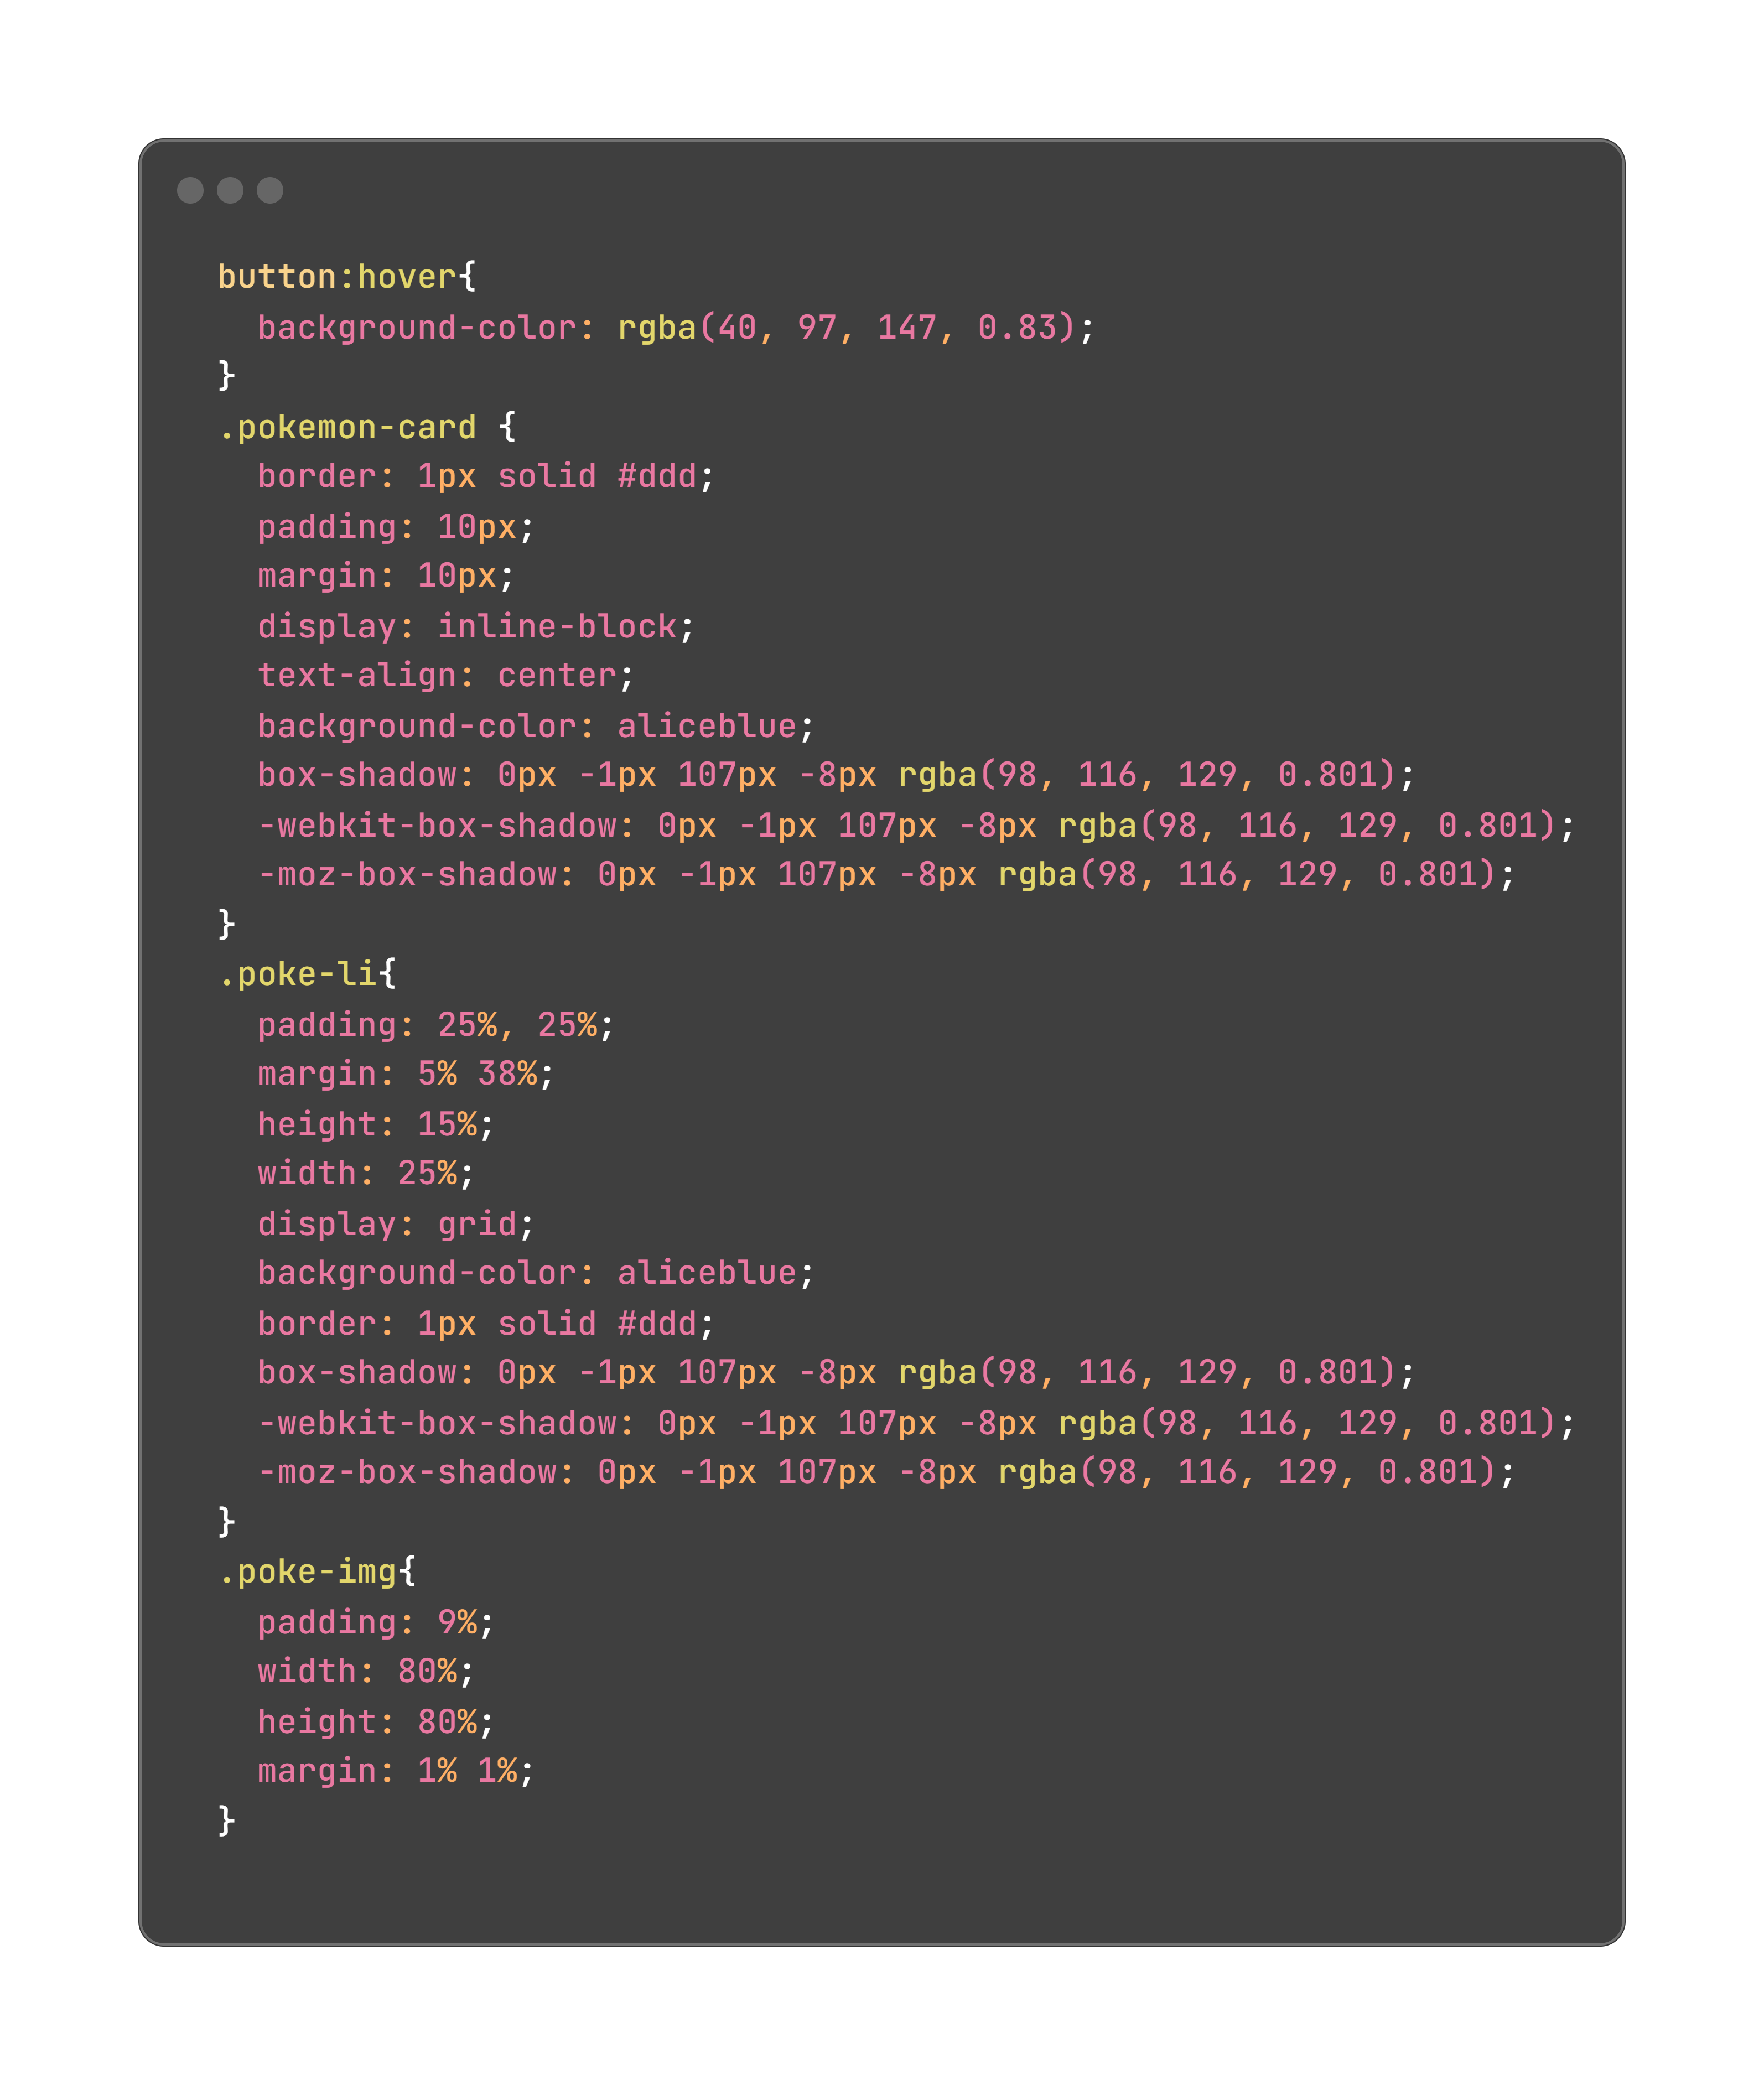
Configuring Global CSS
stylesheet (style.css)
Notes:
body {
background-image: url('https://img.goodfon.com/original/1920x1080/8/39/karamimame-pokemon-pokemony-pokemon-les.jpg');
background-size: cover;
background-position: center;
background-repeat: repeat-y;
height: 100vh;
font-family: Arial, sans-serif;
margin: 0;
padding: 0;
}
.home-container,
.search-container,
.details-container {
background-color: rgba(255, 255, 255, 0.9);
text-align: center;
align-content: center;
margin: 20% 5%;
padding: 2%;
box-shadow: 0px -1px 107px -8px rgba(40, 54, 64, 0.945);
-webkit-box-shadow: 0px -1px 107px -8px rgba(40, 54, 64, 0.945);
-moz-box-shadow: 0px -1px 107px -8px rgba(40, 54, 64, 0.945);
}
.details-container img {
width: 18%;
}
.search-container input{
margin: 1%;
padding: 1% 1%;
text-align: center;
width: 40% ;
}
button {
background-color: rgba(42, 51, 59, 0.83);
color: white;
border: none;
padding: 10px 20px;
cursor: pointer;
margin: 10px;
}
button:hover{
background-color: rgba(40, 97, 147, 0.83);
}
.pokemon-card {
border: 1px solid #ddd;
padding: 10px;
margin: 10px;
display: inline-block;
text-align: center;
background-color: aliceblue;
box-shadow: 0px -1px 107px -8px rgba(98, 116, 129, 0.801);
-webkit-box-shadow: 0px -1px 107px -8px rgba(98, 116, 129, 0.801);
-moz-box-shadow: 0px -1px 107px -8px rgba(98, 116, 129, 0.801);
}
.poke-li{
padding: 25%, 25%;
margin: 5% 38%;
height: 15%;
width: 25%;
display: grid;
background-color: aliceblue;
border: 1px solid #ddd;
box-shadow: 0px -1px 107px -8px rgba(98, 116, 129, 0.801);
-webkit-box-shadow: 0px -1px 107px -8px rgba(98, 116, 129, 0.801);
-moz-box-shadow: 0px -1px 107px -8px rgba(98, 116, 129, 0.801);
}
.poke-img{
padding: 9%;
width: 80%;
height: 80%;
margin: 1% 1%;
}

Slide 20
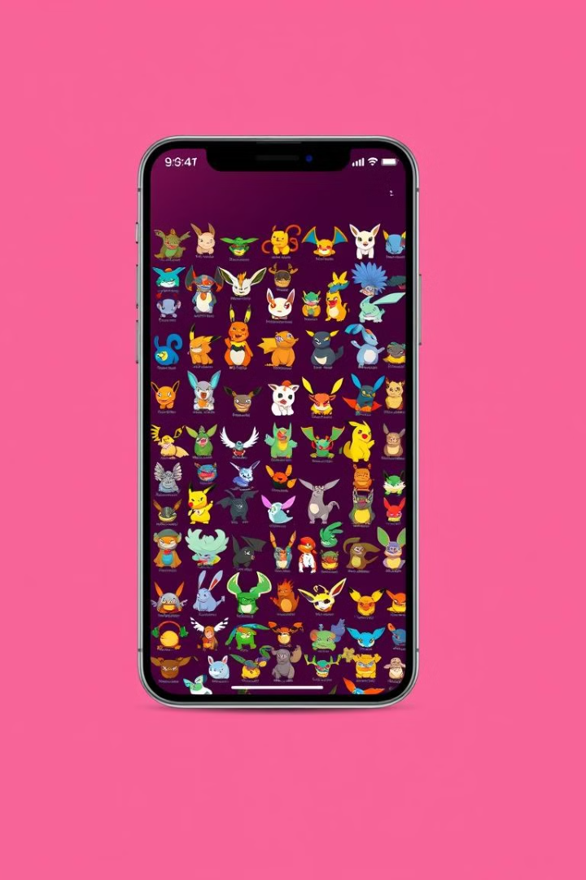


Conclusion: Mastering Poké-powered Angular Apps
By connecting the Angular app to the Pokedex API, you've gained valuable experience with API interactions, built an engaging application, and explored the exciting world of Pokémon.
Keep learning, keep exploring, and continue building amazing applications with Angular and the Pokedex API!
Connect with me on:
LinkedIn:
GitHub:
Any suggestions or feedbacks are welcome, thanks for your time

